Slide 1

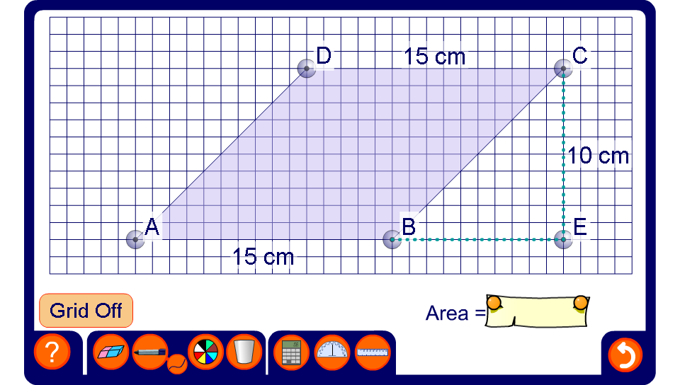


The area of a parallelogram
Notes:
Modify the parallelogram to change its height and its width.
If required use the pen tool to show why the area of the parallelogram is equal to the area of a rectangle with the same base length and height.
The square grid can be turned off once the derivation of the formula has been established.
As an extension activity discuss how we could use Pythagoras’ Theorem to calculate the perimeter of the parallelogram. Investigate how the perimeter changes while the area remains constant.

